Slide 1


Literature Review
03/11/26
By: Kalyani Jaywant Khandait, Daniyar Abykhanov, Dylan Trott​

Slide 2

Density functional theory studies of the antioxidants - a review

Slide 3
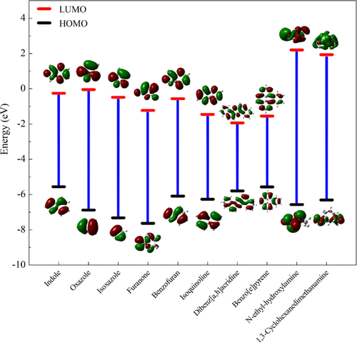
What is Density Functional Theory (DFT)?
Uses electron density information to determine molecular stability
Finds the optimal structure which minimizes the total free energy in a system
DFT is especially useful for describing chemical processes on length scales which cannot be easily understood by characterization techniques
Mohamed, A.; Visco, D. P., Jr.; Breimaier, K.; Bastidas, D. M. Effect of Molecular Structure on the B3LYP-Computed HOMO–LUMO Gap: A Structure–Property Relationship Using Atomic Signatures. ACS Omega 2025, 10 (3), 2799–2808.

Slide 4
Goals of the Paper
Identification of quantum molecular descriptors that best predict antioxidant reactivity
Clarification on the role of reaction mechanism on antioxidant performance
Review of modern literature on DFT antioxidant calculations
Purpose: To address misconceptions and contrasting methods in a well-studied field
Purpose: To inform the scientific community on new findings
Purpose: To suggest considerations for future studies

Slide 5

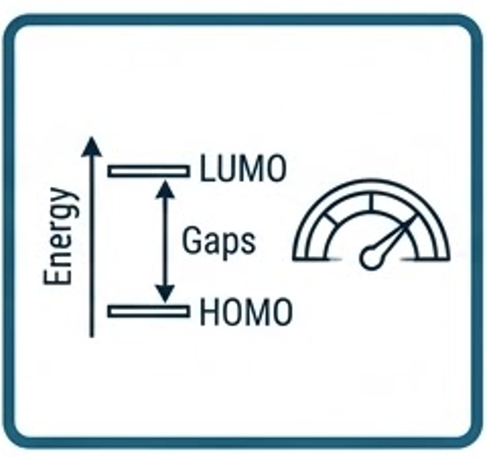


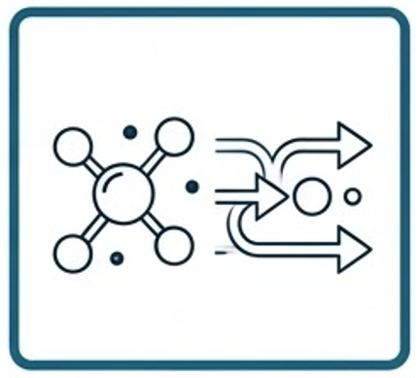
Approach: what were the key steps in their approach?
DFT Calculations
Descriptors
(HOMO, LUMO, Gap, Spin Density)
Apply Koopman’s Theorem
Consider Solvent Effect and Analyze Radical Stabilization
Reaction Mechanism Analysis
(HAT, SET, SPLET)
Koopman’s Theorem : to estimate how much energy is needed to pull an electron off a molecule (Ionization Energy) based on its orbital levels.
HOMO & LUMO (Energy Gaps) : represents a molecule's ability to give or take electrons
HAT, SET, SPLET (The Defense Moves): Three different chemical "handshakes" an antioxidant uses to neutralize a radical by transferring either a hydrogen atom or a single electron.
Images generated by Google Gemini
Notes:
Use Density Functional Theory (DFT)
applied B3LYP functional, a common quantum chemistry method, to calculate molecular electronic properties.
to study molecules theoretically instead of experimentally.
Calculate molecular descriptors They computed several descriptors related to antioxidant activity:
HOMO energy (Highest Occupied Molecular Orbital)
LUMO energy (Lowest Unoccupied Molecular Orbital)
HOMO–LUMO energy gap
Spin Density Distribution (SDD)
Aromaticity
Use Koopmans’ theorem
This was used to estimate electronic properties like ionization energy from orbital energies.
Analyze radical stabilization
They evaluated how stable the radical form of the antioxidant becomes after reacting with a free radical.
Study reaction mechanisms The paper examines antioxidant mechanisms such as:
HAT (Hydrogen Atom Transfer)
SET (Single Electron Transfer)
SPLET (Sequential Proton Loss Electron Transfer)
Consider solvent effects
used Polarizable Continuum Model (PCM) to simulate how solvents affect reactions.

Slide 6
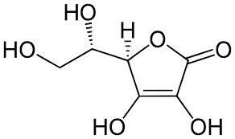
Connecting Molecular Structure to Antioxidant Performance
Performance of antioxidants is directly related to its ability to donate a hydrogen or electron
Common features of 'good' antioxidants:
Conjugation
Hydrogen-donating side groups
Vitamin C
(commonly cited antioxidant)

Slide 7
Using DFT in Our Project
Influenced of Review on our Model Parameters
Structural Features
Use DFT Descriptors
Instead of only using experimental variables, you could include:
Combine theses with structural features from SMILES/Morgan fingerprints ​
Included with environmental variables such as radical type, solvent, temperature, and pH​
HOMO energy
LUMO energy
HOMO-LUMO gap
Bond dissociation energy
Spin density
Molecular structure descriptors
ML Model
predict radical-scavenging rates and rank antioxidant candidates
Notes:
DFT provides electronic descriptors HOMO, LUMO, and the HOMO–LUMO gap
Connect molecular electronic structure to antioxidant performance in a data-driven way
Your project:
Predict reaction rate constants (k values) for radical reactions involving heat stabilizers.
This paper contributes by showing:
Electronic structure determines radical reactivity
HOMO energy → ability to donate electrons
HOMO-LUMO gap → molecular reactivity
Spin density → radical stability
These properties can act as predictive descriptors
Instead of only using experimental variables, you could include:
Possible ML features:
HOMO energy
LUMO energy
HOMO-LUMO gap
Bond dissociation energy
Spin density
Molecular structure descriptors

Slide 8


Results
Chemistry Takeaways
Data Science Takeaways
Molecules with a higher HOMO level and smaller HOMO-LUMO gap are best at scavenging radicals
Radical stabilization through electron delocalization (aromatic rings) is crucial to antioxidant stability
The precise reaction pathway depends primarily on solvent behavior
Structural descriptors and DFT outputs can be combined as ML features for predicting antioxidant performance.
Interpretable models help reveal which molecular patterns control electronic behavior and reactivity.
This approach enables faster screening and ranking of candidate stabilizers before experimental validation.
Symbols generated using Google Gemini

Slide 9
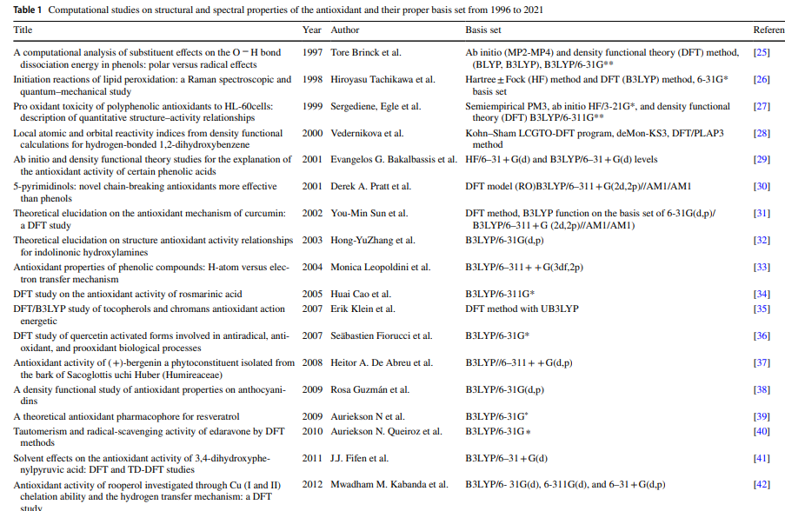
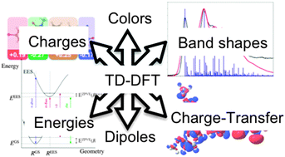
Critique - Strengths
Describes molecular phenomena in a simple but thorough fashion
Explains the physics behind macroscopic material properties
Connects complicated mathematical transforms to straight-forward takeaways
Complete overview of literature developments on DFT antioxidant computation
Lends credibility to their proposed method by explaining past literature shortcomings
Describes the advantage of new developments in DFT computation
A. Adamo and D. Jacquemin, Chem. Soc. Rev., 2013, 42, 845–856, DOI: 10.1039/C2CS35394F.

Slide 10
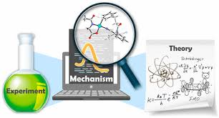
Critique - Weaknesses
No experimental validation!
The paper discusses the computational methods and chemical takeaways, but there is no discussion comparing the accuracy of the models to real world applications
Primarily discusses computational methods as a way of screening candidates, not empirical determination of rate/performance
Cheng, G.-J.; Zhang, X.; Chung, L. W.; Xu, L.; Wu, Y.-D. J. Am. Chem. Soc. 2015, 137, 1706–1725. https://doi.org/10.1021/ja5112749

Slide 11
Any questions?

